Slide 1
Operating Systems
User Interfaces
Dr. Cristina Muntean
Cristina.Muntean@ncirl.ie

Slide 2
Topics covered in this lecture
Different types of User Interface
Command Line Interface (CLI)
Graphical User Interface (GUI)
Batch Interface
Application Programming Interface (API)
Different types of user
Programmer
Operational User
End-User
Relationship between user types and interface types
User interfaces under Windows and Unix -like Operating Systems

Slide 3
2.1 User Interfaces
User Interface (UI) is the outermost layer of a logical operating system
Definition:
UI is a hardware and software which facilitate communication between the user and the computer.
Hardware

Slide 4
2.2 User – Computer Communication Mechanism
UI uses a two way communication mechanism
USER => COMPUTER communication using input devices such as mouse, keyboard, touch screen, microphone, etc. It tells the computer what you want to do.
COMPUTER => USER communication using output devices such as monitor, printer, speaker, etc. The computer shows you what it did.
Both user and computer exchange data or instructions through these devices.

Slide 5
2.3 Types of User Interface
Various types of User Interface:
Command Line Interface (CLI)
Graphical User Interface (GUI)
Batch Interface (Job Control Interface)
Application Programming Interface (API) (System calls)

Slide 6
2.3 Types of User Interface
Command Line Interface (CLI)
Command Line = blank line on screen ready to receive instructions (commands) from the user
CLI allows a user to interact with a computer using a text terminal that provides a command line (prompt)
CLI accepts as input lines of text from the computer’s keyboard and mouse and provides as output a text displayed on the computer monitor or a sound
Have you used a CLI?

Slide 7
2.3 Types of User Interface
Command Line Interface (CLI) (cont)
How CLI works?
the user types a command on the keyboard
the user terminates the command usually with the ‘Enter’ key
the computer executes the command
the computer provides textual output
A number of commands can be grouped in a file and we execute them as a group
Command line interpreter (shell) = A program that implements the CLI
Examples:
Unix’s shells (sh, ksh, csh, tcsh, bash, etc.)
DOS’s Command.com (“Command Prompt”)
MS Windows offers CLI in a command window

Slide 8
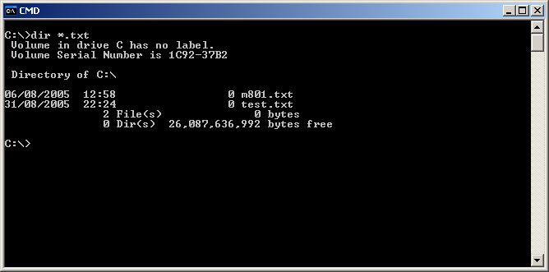
2.3 Types of User Interface
Command Line Interface (CLI) (cont)
DOS Command Prompt (Windows)
Command Format
doAction toFile
or
doAction < inputFile > outputFile
Examples
dir
echo Hello!
echo Hello! >myfile.txt
doAction – a command (e.g. open, print) to be executed
<, > are redirection characters
>outputFile - send the output of the previous command (that is on the left of '>') to a
file (outputFile) and not on the screen
<inputFile - the command (doAction) takes as input data stored in the inputFile

Slide 9
2.3 Types of User Interface
Command Line Interface (CLI) (cont)
Exercise
Open the MS Windows Command Prompt Interface
Type in the following commands (one by one)
cd c:\ Changing the directory to c folder
dir Shows the available files and folders in the current directory
echo Hello! Repeat the typed text to the screen
echo Hello! >myfile.txt Save the text into myfile.txt
md john Create your own directory called “john”
copy myfile.txt john Copy one or more files to an alternate location
del john Delete files within “john” folder
dir | sort pipes output from “dir” command to “sort” command. The
output from “sort” is sent to the screen
NOTE: Be carefully what files you delete!

Slide 10
2.3 Types of User Interface
Command Line Interface (CLI) (cont)
Similar commands can be executed using the Shell CLI provided by Unix
The commands may have different format under different CLIs
Exercises on Unix-like OS will be done in the lab session

Slide 11
2.3 Types of User Interface
Command Line Interface (CLI) (cont)
Advantages of CLI
Relatively simple commands can be connected together to perform more complex tasks and to achieve a very flexible range of results
Skilled users can perform many tasks faster by using CLI instead of GUI
Operations are often invoked one “level” away from the basic command. With GUI options appear in different menus and on various menu levels

Slide 12
2.3 Types of User Interface
Command Line Interface (CLI) (cont)
Disadvantages of CLI
More difficult to learn to use CLI. Especially for non-technical persons
CLIs are unsuited to certain tasks, such as image and sound editing
Multitasking command line environments do not offer the possibility to view multiple things at once on one screen.
multitasking = ability to run multiple programs/commands and/or multiple instances of a single program/command simultaneously

Slide 13
2.3 Types of User Interface
Graphical User Interface (GUI)
WordNet Dictionary Definition:
“user interface based on graphics (icons and pictures and menus) instead of text; uses a mouse as well as a keyboard as an input device
GUI :
accepts input via devices such as computer keyboard and mouse
provides graphical output on the computer monitor
Macintosh has introduced the first GUI for personal computers in 1983 in Apple Computer's Lisa. Later on, Macintosh's GUI style inspired other PC manufacturers.
In 1985 Microsoft introduced Windows, a GUI for MS-DOS–based computers

Slide 14
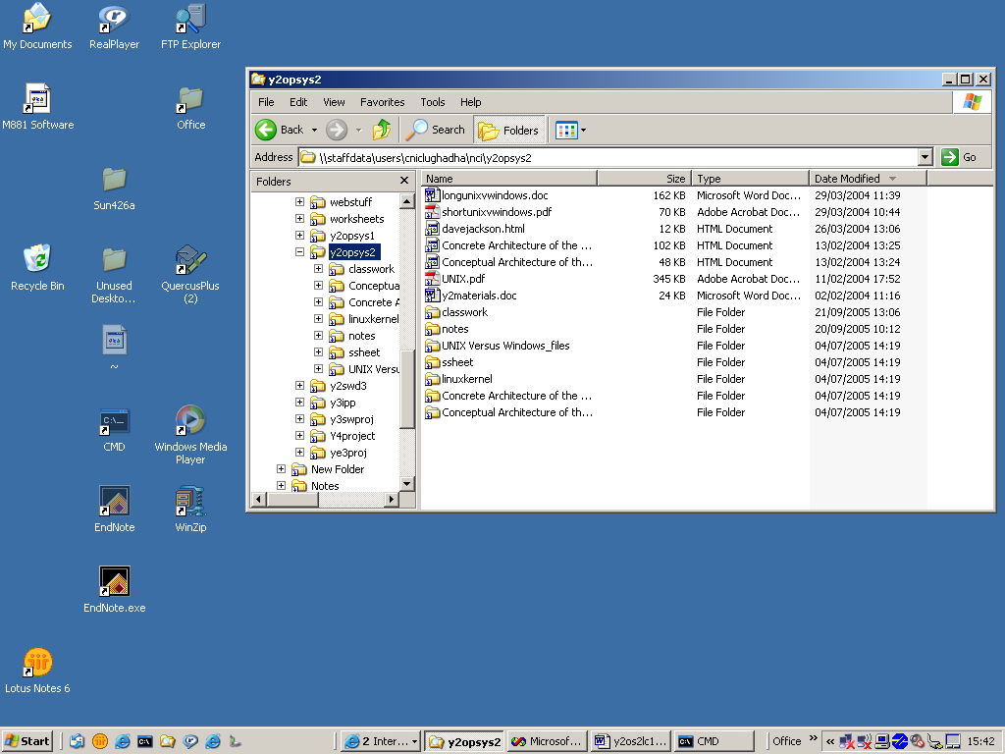
2.3 Types of User Interface
Graphical User Interface (GUI) (cont.)
Example of GUI offered by Microsoft Windows

Slide 15
2.3 Types of User Interface
Graphical User Interface (CLI) (cont)
Exercise
Open Windows Explorer within MS Windows operating system to visualise the structure of the folders on your computer
Visualise the files /folders located in the H directory (your home folder)
Create a file named “myfilewin.txt”
Create a folder named “johnwin”
Copy the “myfilewin.txt” file into “johnwin” folder
Delete the “myfilewin.txt” file within “johnwin” folder
Which UI did you find being easier to use?

Slide 16
2.3 Types of User Interface
Graphical User Interface (GUI) (cont.)
Currently, GUIs are used as:
operating-system interfaces
To select commands, work with the files, start programs, execute tasks
The mouse is used to point to pictorial symbols (icons) or lists of menu choices and to perform an action. No type in text commands.
Example: Mac OS, Microsoft Windows, X Windows System
Web-based user interfaces
provide as output web pages transported via the Internet and visualised with a Web browser application
application specific interfaces
touch-screen GUIs for applications such as: airline self check-in, information kiosks
3D GUI
common in science fiction movies (e.g.Jurassic Park)
currently used in computer games, art and computer aided design

Slide 17
2.3 Types of User Interface
Graphical User Interface (GUI) (cont.)
Advantages of GUIs
make computer operation more intuitive, and easier to learn and use
drag-and-drop a file using mouse vs command(s) based task
provide users with immediate, visual feedback on the effect of an action (e.g. delete file)
allow users to take full advantage of the powerful multitasking capability offered by the modern OSs
multitasking = ability to run multiple programs and/or multiple instances of a single program simultaneously
Disadvantages of GUIs
intensive use of the processor’s power in order to display the graphic elements or to perform multitasking operations
More complex to develop a GUI

Slide 18
2.3 Types of User Interface
Batch Interface (Job Control Interface )
Batch Interface (BI) = non-interactive user interface.
How BI works?
The user specifies all the details (e.g. commands) for a batch job => batch file
A batch system processes the batch file
The output is provided when all the processing is done
The computer does not require input data after the processing has started.
Batch File = a file that contains a sequence of systems commands for performing a particular task

Slide 19
2.3 Types of User Interface
Application Programming Interface (API )
API = A language used by an application program (developed by a programmer) to communicate with the operating system or other control programs (e.g. database management systems, communications protocol)
APIs exist for operating systems, file systems, database systems, networking systems, etc.
Most operating systems make API available to the programmers to invoke system calls within a program
E.g. open/close a file, release a block of memory, get the system’s date and time
Windows NT provides an API called WIN32 API that is the official OS interface to all Microsoft Operating Systems.

Slide 20
2.4 Categories of people that may interact with an UI
1. Programmer
A person that produces a software for himself or for others
Application programmer produces programs for “Users”. E.g. databases, spreadsheets, word processors, mortgage repayment calculators,
Systems programmer produces low level software (E.g. Operating Systems, Compilers )
Systems programmer uses system calls via the API to make requests directly to the Operating System.

Slide 21
2.4 Categories of people that may interact with an UI
2. Operational User
A person responsible for providing PC/system related facilities to the others.
E.g. Operators, Network administrators
Needs wide ranging access to the system resources in order to perform various tasks (e.g. delete/move files, adjust process priorities)

Slide 22
2.4 Categories of people that may interact with an UI
3. End-User
A person for whom a hardware or software product is designed
The term “end-user” makes the differentiation between the user for which the product is designed, and the other users (e,g, designers, developers, installers) who are making the product possible for the end-user
The end-user may use a hardware or software product to solve a problem, produce a document, record some data, etc.
The end-user may or may not need extra skills
E.g. ATM user vs. Legal Secretary using Word
NOTE: One person may at different times perform tasks within each of the categories!

Slide 23
Your Turn: Answer the Questions
1) Which class of user is each of the following?
Software engineer preparing her monthly expense claim in Excel
Parent configuring Internet Explorer on a home PC.
Student sending email to a friend
Accountant editing a .BAT file to schedule regular backups of his hard drive
2) What type of user interface is used by each of the following?
Software engineer writing operating system extension
Computer Operator running batch jobs on a mainframe system
NT Administrator running batch jobs on Windows NT system
Student ordering books on Amazon.COM
Sales assistant scanning purchases at a supermarket checkout
Java programmer writing a program using Visual Studio

Slide 24
Your Turn: Answer the Questions
Exercises
Give new examples ( ie not from the Notes ) of users doing a task and identify which type they are.
What type of user interface has the AERTEL system on RTE television? Explain.
What is meant by a GUI? What are its characteristics?

Slide 25
Learning Outcome
After this lecture you should have an understanding of what a User Interface is and where it fits on our logical Operating System.
You should know the following:
4 different type of User Interface and their characteristics, advantages and disadvantages
3 different classes of User and their distinguishing features

